Slide 1
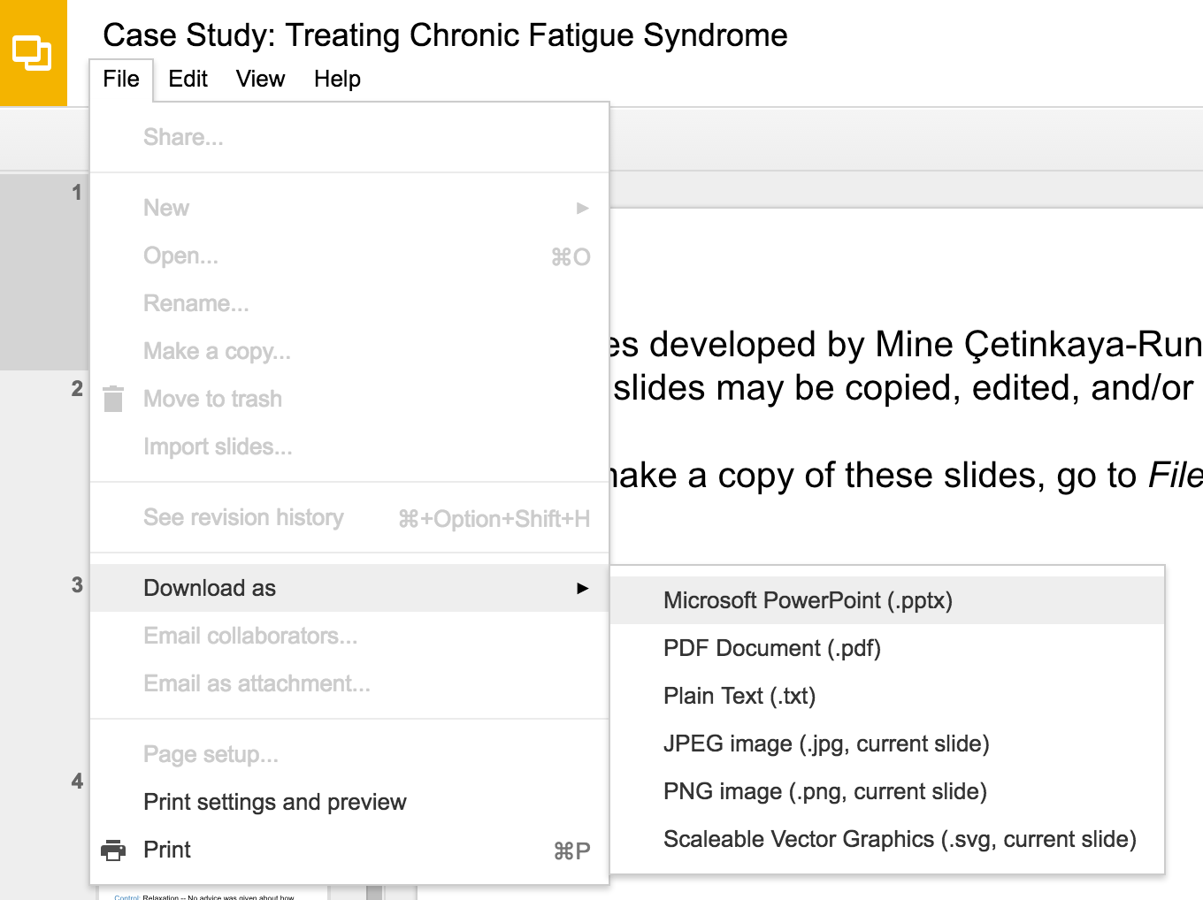
Slides developed by Mine Çetinkaya-Rundel of OpenIntro
Translated from LaTeX to Google Slides by Curry W. Hilton of OpenIntro.
The slides may be copied, edited, and/or shared via the CC BY-SA license
To make a copy of these slides, go to File > Download as > [option], as shown below. Or if you are logged into a Google account, you can choose Make a copy... to create your own version in Google Drive.

Slide 2
Types of outliers in linear regression

Slide 3
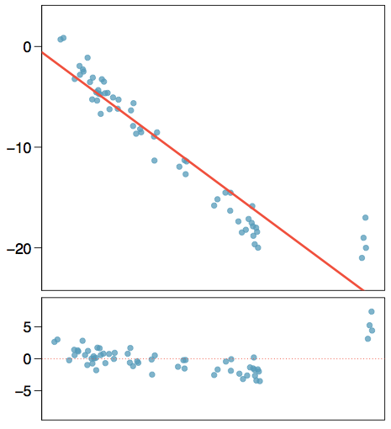
Types of outliers
How do outliers influence the least squares line in this plot?
To answer this question think of where the regression line would be with and without the outlier(s). Without the outliers the regression line would be steeper, and lie closer to the larger group of observations. With the outliers the line is pulled up and away from some of the observations in the larger group.

Slide 4
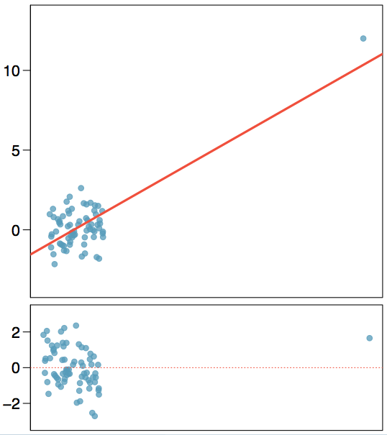
Types of outliers
How do outliers influence the least squares line in this plot?

Slide 5
Types of outliers
How do outliers influence the least squares line in this plot?
Without the outlier there is no evident relationship between x and y.

Slide 6
Some terminology
Outliers are points that lie away from the cloud of points.

Slide 7
Some terminology
Outliers are points that lie away from the cloud of points.
Outliers that lie horizontally away from the center of the cloud are called high leverage points.

Slide 8
Some terminology
Outliers are points that lie away from the cloud of points.
Outliers that lie horizontally away from the center of the cloud are called high leverage points.
High leverage points that actually influence the slope of the regression line are called influential points.

Slide 9
Some terminology
Outliers are points that lie away from the cloud of points.
Outliers that lie horizontally away from the center of the cloud are called high leverage points.
High leverage points that actually influence the slope of the regression line are called influential points.
In order to determine if a point is influential, visualize the regression line with and without the point. Does the slope of the line change considerably? If so, then the point is influential. If not, then it’s not an influential point.

Slide 10
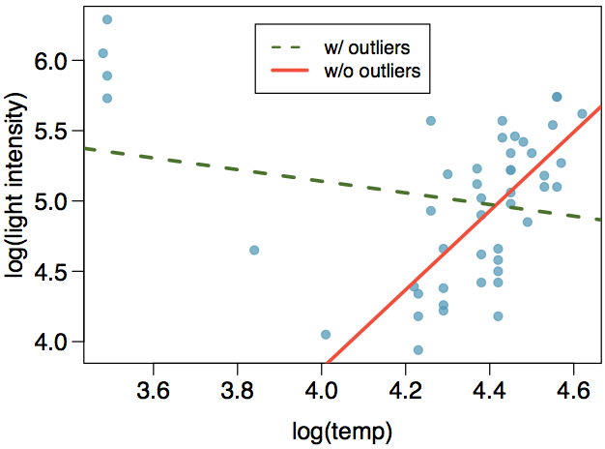
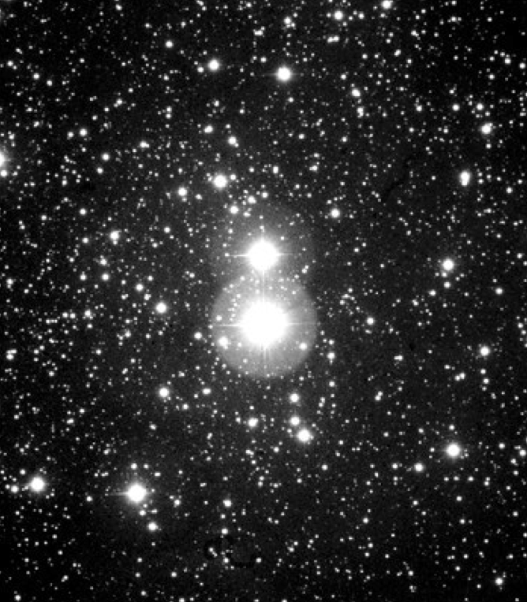
Influential points
Data are available on the log of the surface temperature and the log of the light intensity of 47 stars in the star cluster CYG OB1.

Slide 11
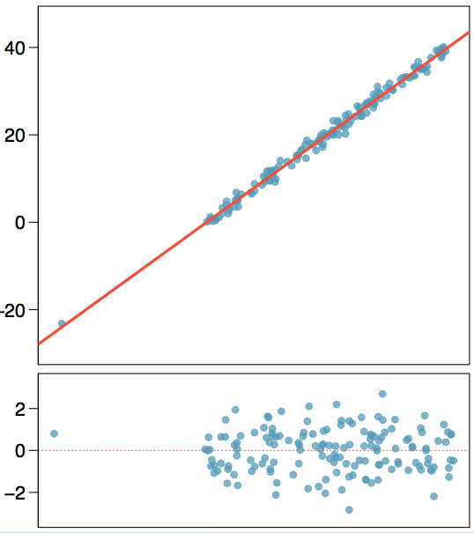
Types of outliers
Which of the below best describes the outlier?
influential
high leverage
none of the above
there are no outliers

Slide 12
Types of outliers
Which of the below best describes the outlier?
influential
high leverage
none of the above
there are no outliers

Slide 13
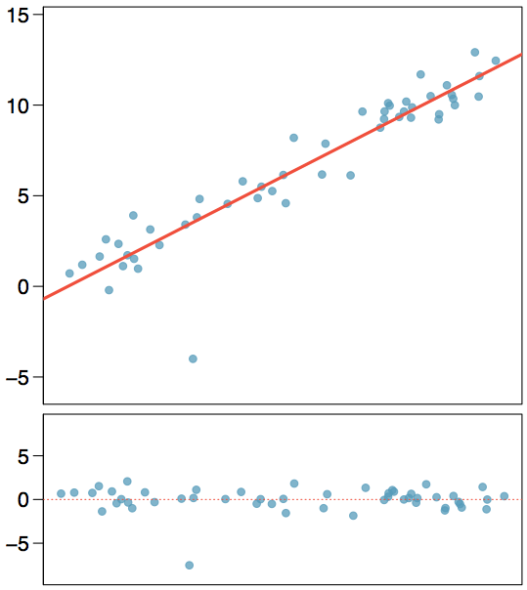
Types of outliers
Does this outlier influence the slope of the regression line?

Slide 14
Types of outliers
Does this outlier influence the slope of the regression line?
Not much...

Slide 15
Recap
Which of following is true?
Influential points always change the intercept of the regression line.
Influential points always reduce R².
It is much more likely for a low leverage point to be influential, than a high leverage point.
When the data set includes an influential point, the relationship between the explanatory variable and the response variable is always nonlinear.
None of the above.

Slide 16
Recap
Which of following is true?
Influential points always change the intercept of the regression line.
Influential points always reduce R².
It is much more likely for a low leverage point to be influential, than a high leverage point.
When the data set includes an influential point, the relationship between the explanatory variable and the response variable is always nonlinear.
None of the above.

Slide 17
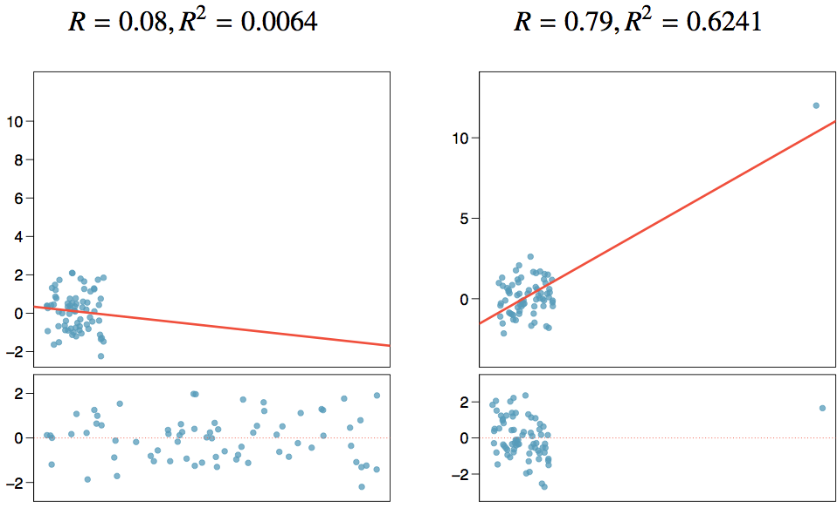
Recap (cont.)

Slide 18
Find more resources at openintro.org/os, including
Slides
Videos
Statistical Software Labs
Discussion Forums (free support for students and teachers)
Learning Objectives
Teachers only content is also available for Verified Teachers, including
Exercise solutions
Sample exams
Ability to request a free desk copy for a course
Statistics Teachers email group
Questions? Contact us.

